Slide 1
Why build models?

Slide 2
Why build models?
To help explain some empirical result
To help formulate a theory
Theoretical
Intuitions
Data
Analysis
Experiment
Model
Theoretical
Intuitions
Data
Analysis
Experiment
Model

Slide 3
Modeling approaches
Formal logic
Production systems (e.g SOAR, ACT-R)
Neural networks
Dynamic systems
Probabilistic models

Slide 4
Why build probabilistic models?
For us: probabilities are degrees of belief
Probability theory captures the right way to update degrees of belief
“The theory of probabilities is at bottom only common sense reduced to calculus; it makes us appreciate with exactitude that which exact minds feel by a sort of instinct without being able oft times to give a reason for it” (Laplace)

Slide 5
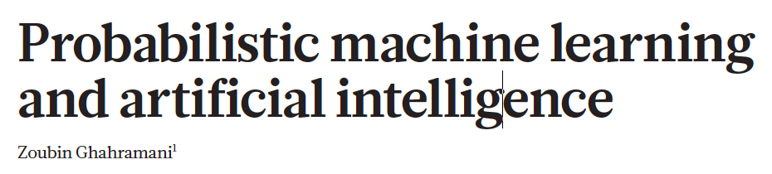
Applications of probability theory
Cognitive
Models
AI and
Machine
Learning
Data
Analysis

Slide 6
InDUCTIVE INFERENCE
Module 1

Slide 7

Inductive inference
Coughing friend

Slide 8
Inductive inference
John has a cold
Coughing friend

Slide 9
Inductive inference
John has emphysema
Coughing friend

Slide 10
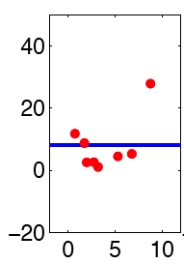
Inductive inference
Coughing friend
Curve fitting

Slide 11
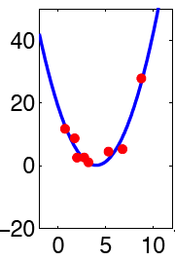
Inductive inference
John has a cold
Coughing friend
Curve fitting

Slide 12
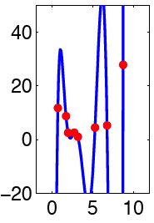
Inductive inference
John has emphysema
Coughing friend
Curve fitting

Slide 13
Curve fitting
D:
h₁: h₂: h₃:
P(h|d) α P(d|h) P(h)
Posterior
probability
Prior
knowledge
Evidence
Notes:
Sketch bar graphs on the board

Slide 14

Language
Causes
Objects
Number
Folk Physics
Light
Sound

Slide 15
Building a Bayesian model
What are the observed data?
What are the hypotheses?
What is the prior?
What is the likelihood?
Posterior
Likelihood
Prior
P(h|d) α P(d|h) P(h)

Slide 16
Take home messages
Bayesian models are useful for thinking about inductive problems.
There are many inductive problems from a wide range of domains including vision, language, motor control, etc.

Slide 17
Bayesian Networks (DIRECTED GRAPHICAL MODELS)
Module 3

Slide 18
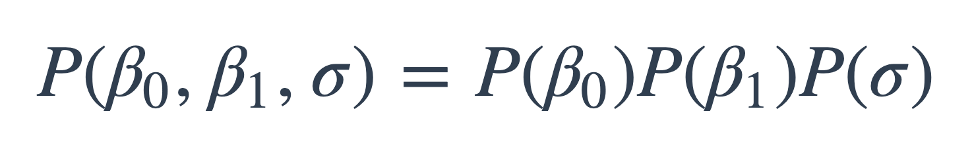
Representing hypothesis spaces and priors
Coughing patient:
we just enumerated the hypothesis space
Bayesian regression:
we assumed
What if the hypothesis space is huge – how do we come up with all the numbers in the prior?

Slide 19
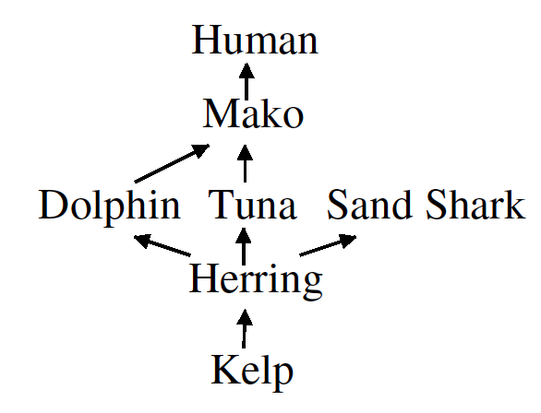
Food web problem
Herring carry a certain disease.
How likely is it that mako have the same disease?

Slide 20
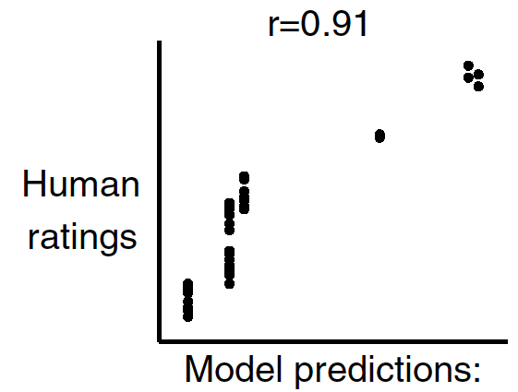
Food web problem
(Shafto et al, 2008)

Slide 21
Building a Bayesian model
What are the observed data?
What are the hypotheses?
What is the prior?
What is the likelihood?
Posterior
Likelihood
Prior
P(h|d) α P(d|h) P(h)

Slide 22
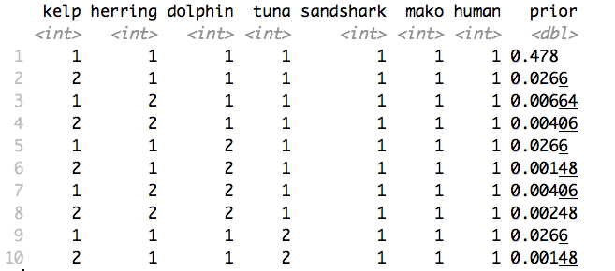
Hypothesis space and prior

Slide 23
Specifying a prior
Kelp
Herring
Dolphin
Tuna
Mako

Slide 24
Specifying a prior
Kelp
P(K = 1) = 0.1
Herring
Dolphin
Tuna
Mako

Slide 25
Specifying a prior
Kelp
P(K = 1) = 0.1
K | P(H = 1 |K)
0 | 0.1
1 | 0.55
Herring
Dolphin
Tuna
Mako

Slide 26
Specifying a prior
Kelp
P(K = 1) = 0.1
K | P(H = 1 |K)
0 | 0.1
1 | 0.55
Herring
Dolphin
Tuna
D | T | P(M = 1 |D, T)
0 | 0 | 0.1
0 | 1 | 0.55
1 | 0 | 0.55
1 | 1 | 0.775
Mako

Slide 27
Specifying a prior
Kelp
P(K, H, D, T, M) =
P(K) *
P(H|K) *
P(D|H) *
P(T|H) *
P(M|D,T)
Herring
Dolphin
Tuna
Mako

Slide 28
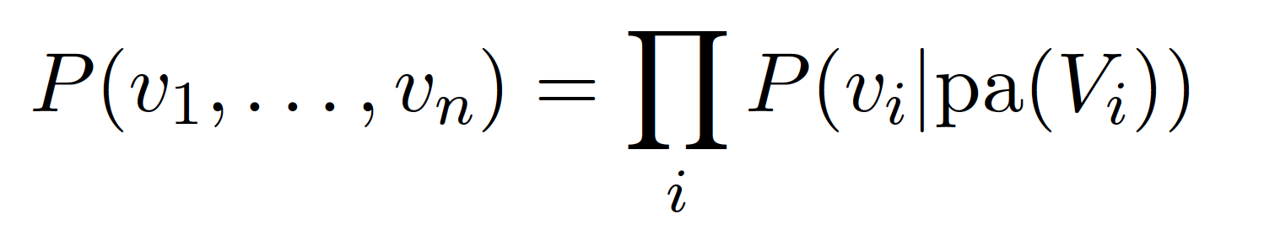
General formulation

Slide 29
Specifying a prior
Kelp
P(K = 1) = 0.1
K | P(H = 1 |K)
0 | 0.1
1 | 0.55
Herring
Dolphin
Tuna
D | T | P(M = 1 |D, T)
0 | 0 | 0.1
0 | 1 | 0.55
1 | 0 | 0.55
1 | 1 | 0.775
Mako

Slide 30
Specifying a prior
b: base rate
t: transmission rate
Kelp
P(K = 1) = b
K | P(H = 1 |K)
0 | b
1 | 1 – (1-t)(1-b)
Herring
Dolphin
Tuna
D | T | P(M = 1 |D, T)
0 | 0 | b
0 | 1 | 1 - (1-t)(1-b)
1 | 0 | 1 - (1-t)(1-b)
1 | 1 | 1 – (1-t)(1-t)(1-b)
Mako

Slide 31
Exercise: Food web (enumeration)

Slide 32
Take home messages
Bayes nets give us a good way to specify priors

Slide 33
INFERENCE BY SAMPLING FROM THE PRIOR
Module 4

Slide 34
Sampling from the prior
Kelp
P(K = 1) = 0.1
K | P(H = 1 |K)
0 | 0.1
1 | 0.55
Herring
Dolphin
Tuna
D | T | P(M = 1 |D, T)
0 | 0 | 0.1
0 | 1 | 0.55
1 | 0 | 0.55
1 | 1 | 0.775
Mako

Slide 35
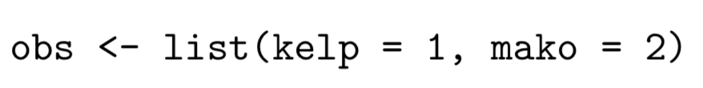
Sample based predictions
Collect set of samples from prior
Remove all those that are inconsistent with the observations
Make predictions based on samples that remain
Kelp
Herring
Dolphin
Tuna
Mako

Slide 36
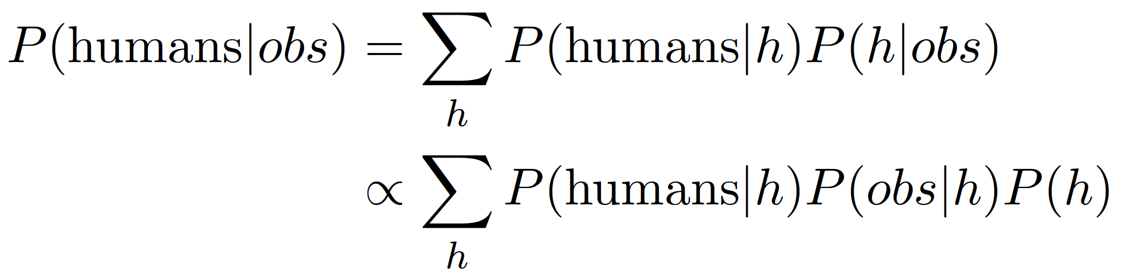
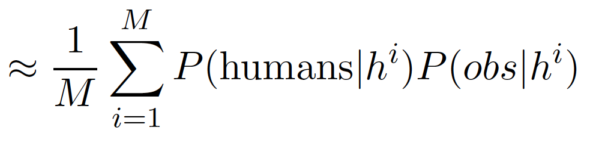
Sample based predictions

Slide 37
Exercise: Food web (sampling from the prior)

Slide 38
Take home messages
Bayes nets give us a good way to specify priors
Sampling is often a good way to implement probabilistic inference

Slide 39
JAGS
Module 5

Slide 40
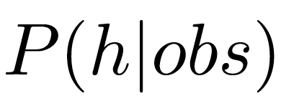
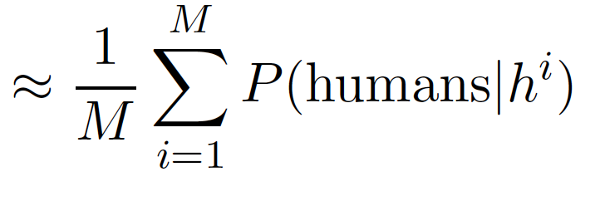
Sample based predictions
If we could sample from the posterior

Slide 41
JAGS and STAN
Widely used for data analysis and cognitive modeling

Slide 42
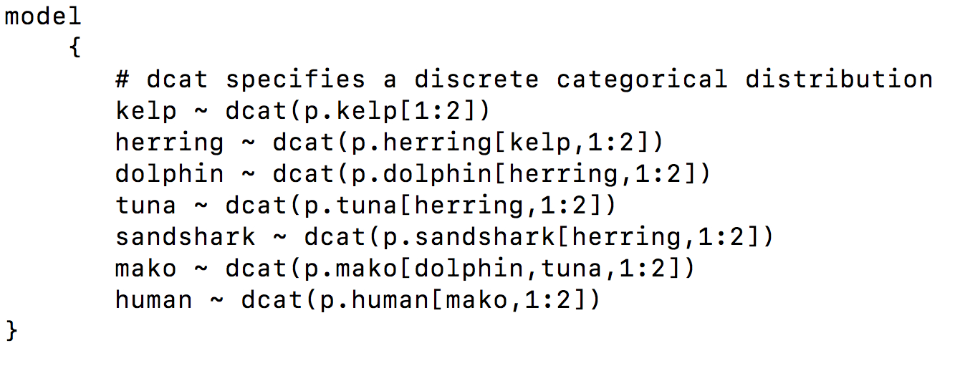
JAGS : model specification

Slide 43
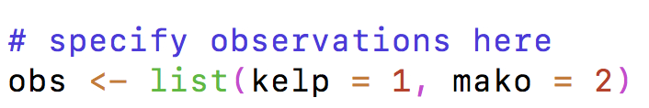
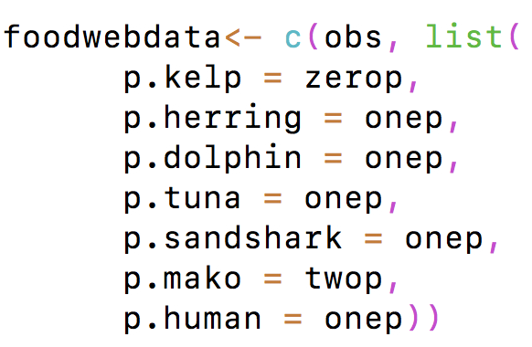
JAGS : observations and CPDs

Slide 44
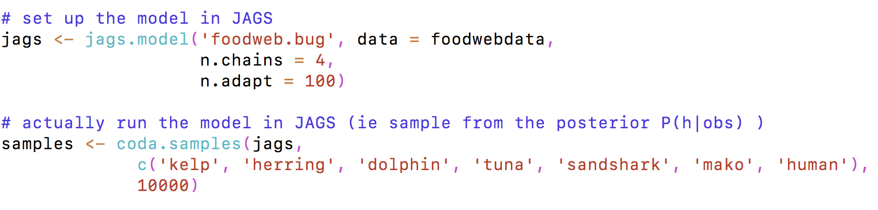
Running JAGS

Slide 45
Exercise: Food web (sampling from the posterior using JAGS)

Slide 46
Take home messages
Bayes nets give us a good way to specify priors
Sampling is often a good way to implement probabilistic inference
Tools like JAGS make sampling-based inference relatively simple in many contexts

Slide 47
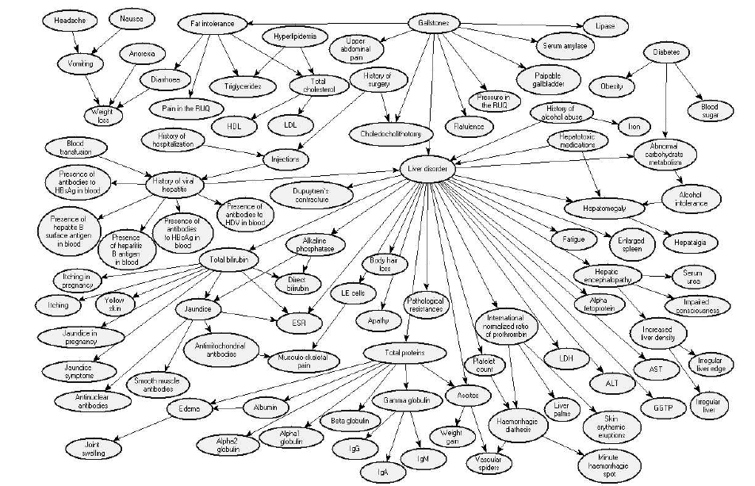
Medical diagnosis

Slide 48
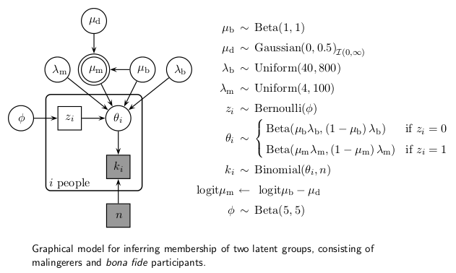
Bayes nets

Slide 49
Bayes nets
When you’re starting any modeling project
Try to write down the relevant variables
Draw a graph to show how the variables are related to each other

Slide 50
Bayes Nets and causal reasoning
Bayes nets support reasoning about:
Interventions
Counterfactuals

Slide 51
Take home messages
Bayes nets are:
a useful engineering tool
a tool for thinking

Slide 53
SAMPLING FRAMES AND SPHERES OF SODOR
Module 6

Slide 54
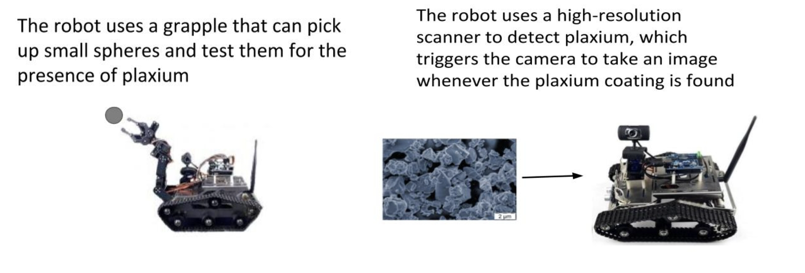
Sampling frames
Category sampling
Property sampling

Slide 55
Human data

Slide 56
Building a Bayesian model
What are the observed data?
What are the hypotheses?
What is the prior?
What is the likelihood?
Posterior
Likelihood
Prior
P(h|d) α P(d|h) P(h)

Slide 57
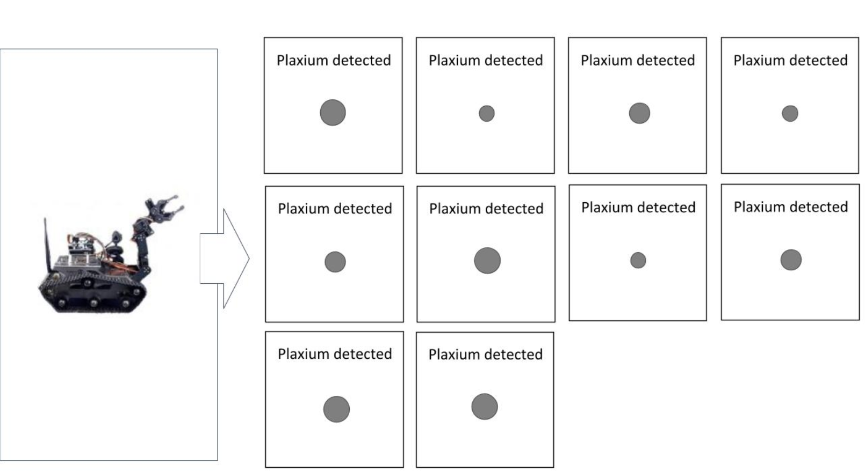
Observations

Slide 58
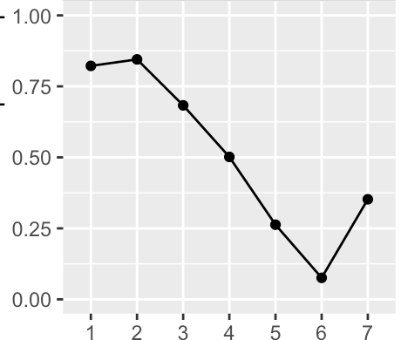

Hypotheses
category_means
Proportion with plaxium
category

Slide 59
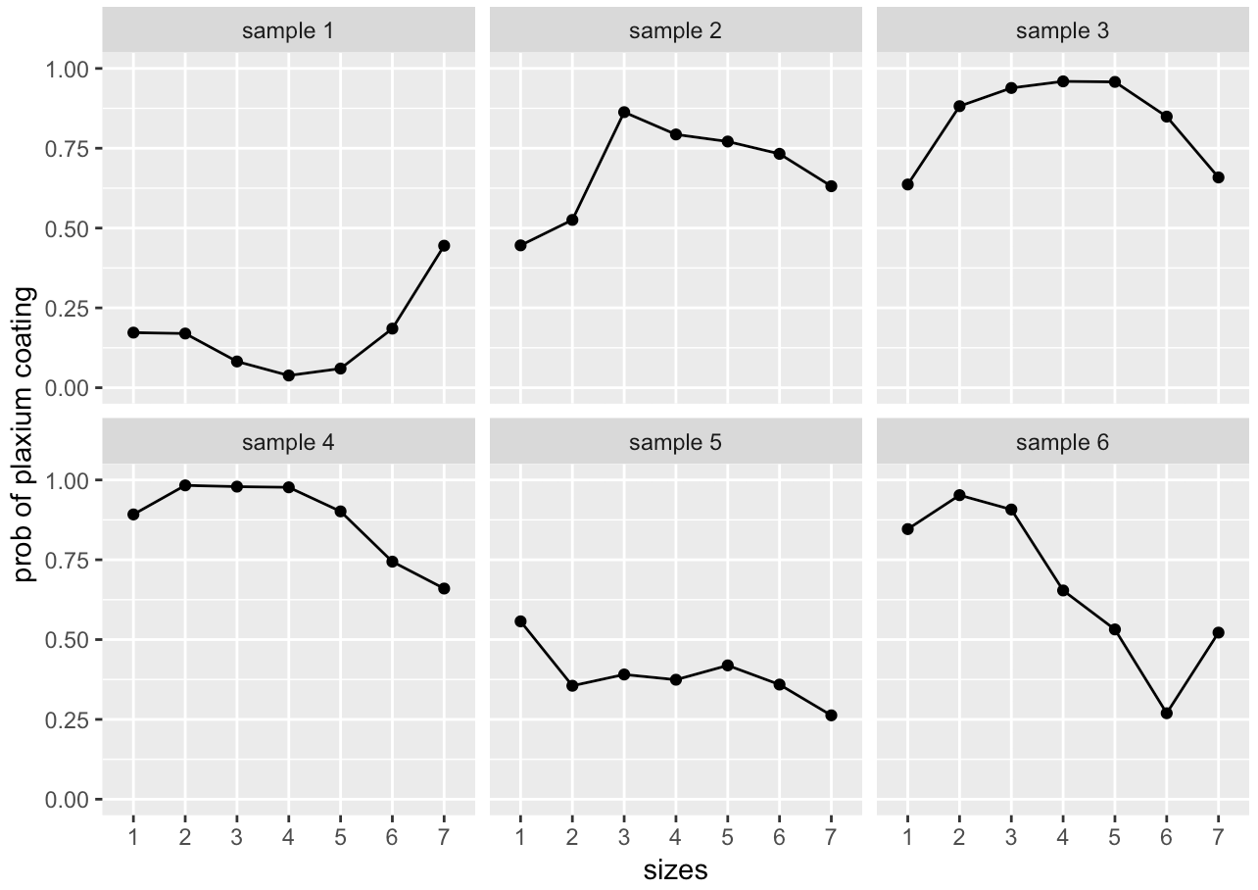
Prior on category means

Slide 60
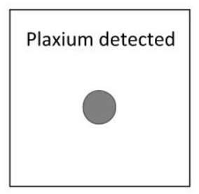
Category sampling
category_means
plaxium
category

Slide 61
Category sampling
mean_gp
category_means
plaxium
category

Slide 62
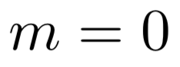
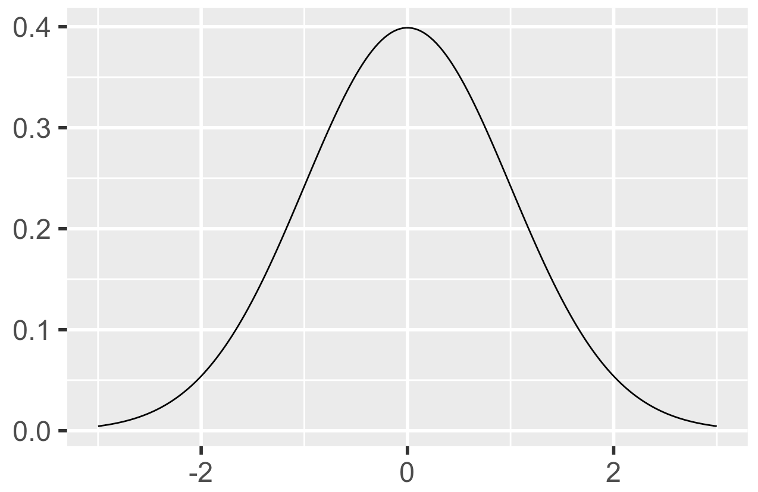
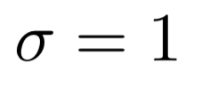
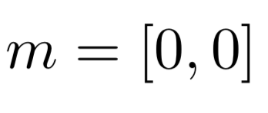
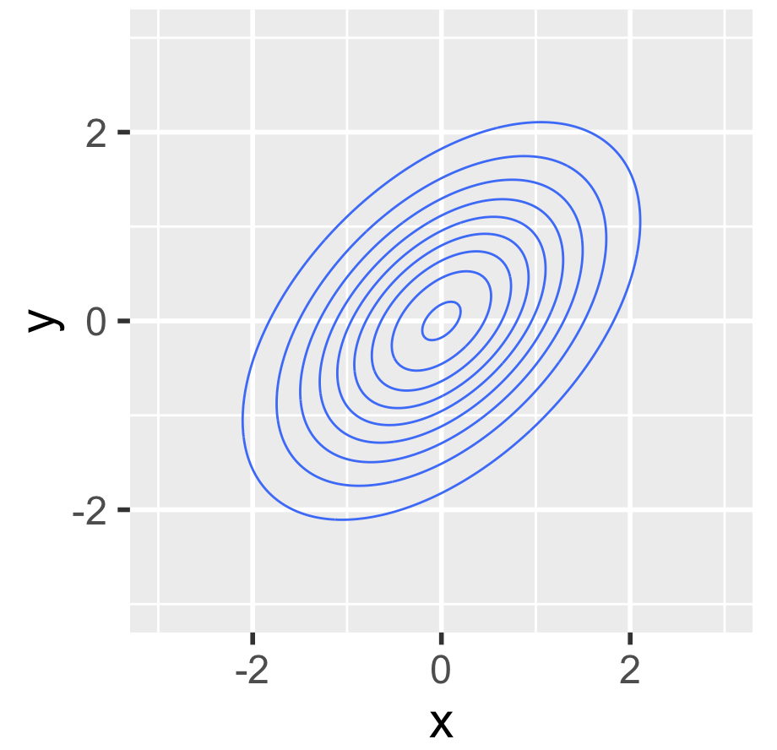
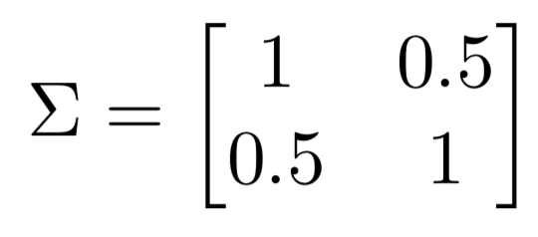
Gaussian distributions

Slide 63
Category sampling
m
cov_gp
mean_gp
category_means
plaxium
category

Slide 64
Category sampling
sigma
tau
rho
m
cov_gp
mean_gp
category_means
plaxium
category

Slide 65
Property sampling
category_means
base
plaxium
category

Slide 66
Property sampling
sigma
tau
rho
m
cov_gp
mean_gp
category_means
base
plaxium
category

Slide 67
Property sampling
sigma
tau
rho
m
cov_gp
mean_gp
alpha
category_means
base
plaxium
category

Slide 68
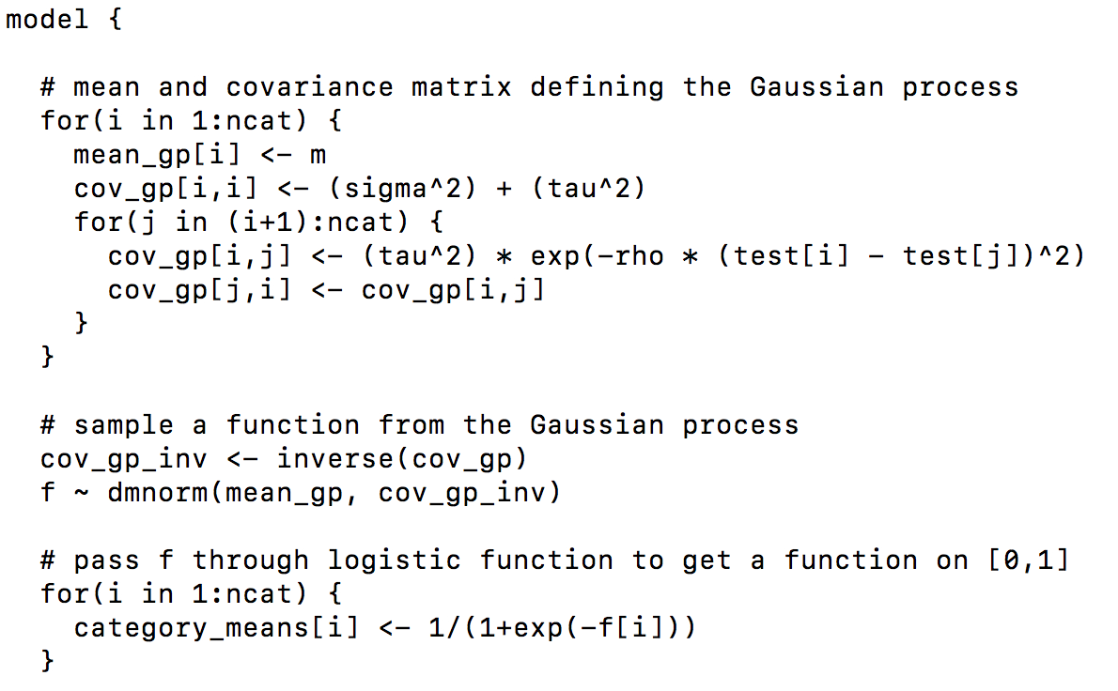
Inference with JAGS
Category sampling
category.bug
sigma
tau
rho
m
cov_gp
mean_gp
category_means
plaxium
category

Slide 69
Exercise: Sampling frames

Slide 70
Take home messages
Bayes nets let you build relatively complex models out of simple pieces
JAGS makes the implementation process relatively painless

Slide 71
TAKING STOCK

Slide 72
Today’s models
How are the models we’ve discussed useful?
And what are their limitations?

Slide 73
Bayesian models in general
Can Bayesian models be useful for thinking about problems you’re interested in?
Where might they be not so useful?

